Slide 1
Welcome & Purpose
Troop Parent Kickoff 2025–2026
Introductions (Committee Chair, Scoutmaster, Leadership)
Meeting goals: Program Overview, Safety, Parent Involvement

Slide 2
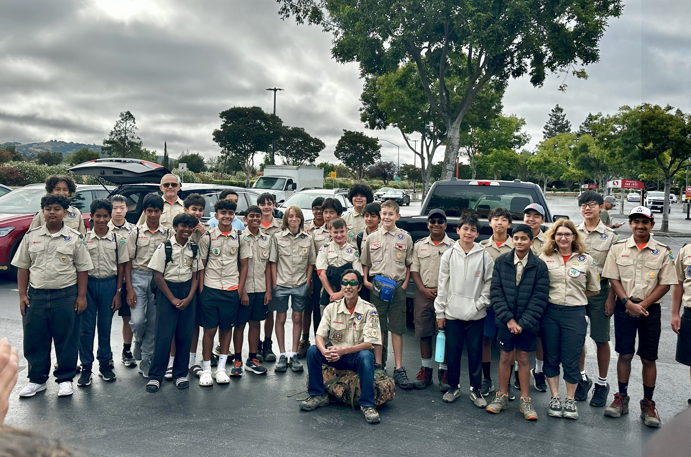
Year at a Glance
Monthly Campouts, Service Projects, Summer Camp, Courts of Honor
Examples of diverse outings:
Beach overnight October
Angel Island Backpacking
Summer Camp

Slide 3
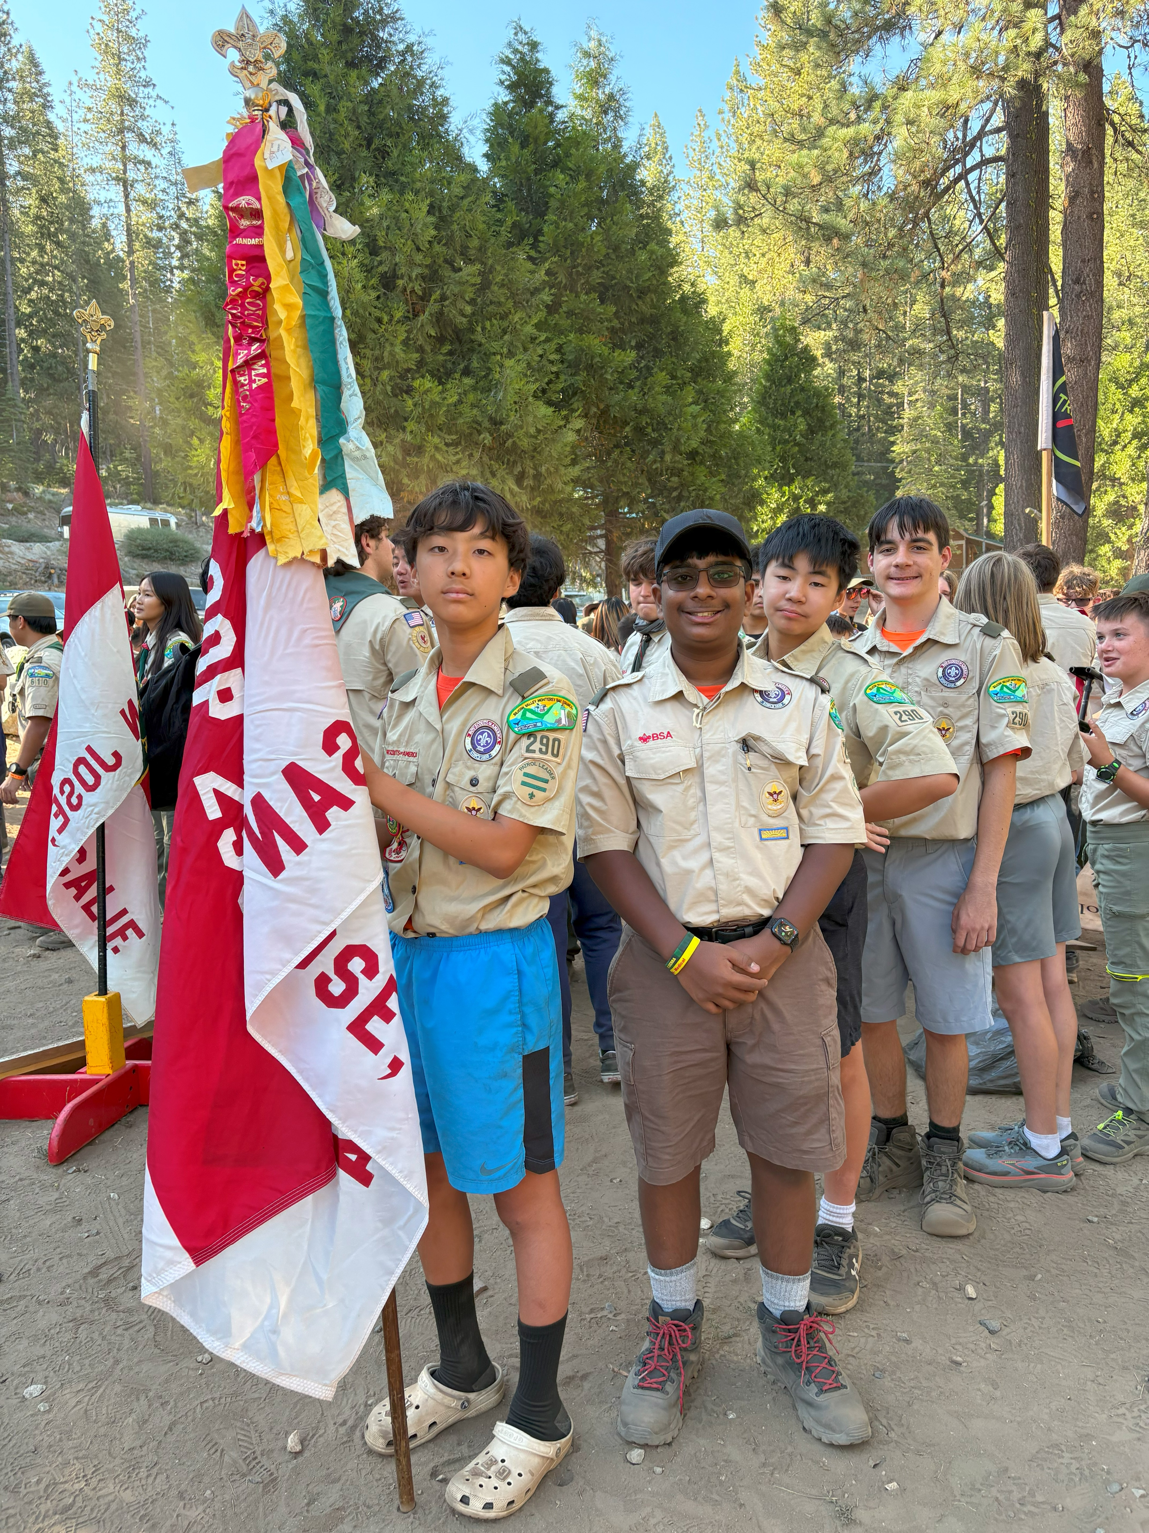
Program & Youth Leadership
What 'boy-led' means
PLC role & structure
Advancement pathway + merit badge process
Scoutbook (Plus)

Slide 4
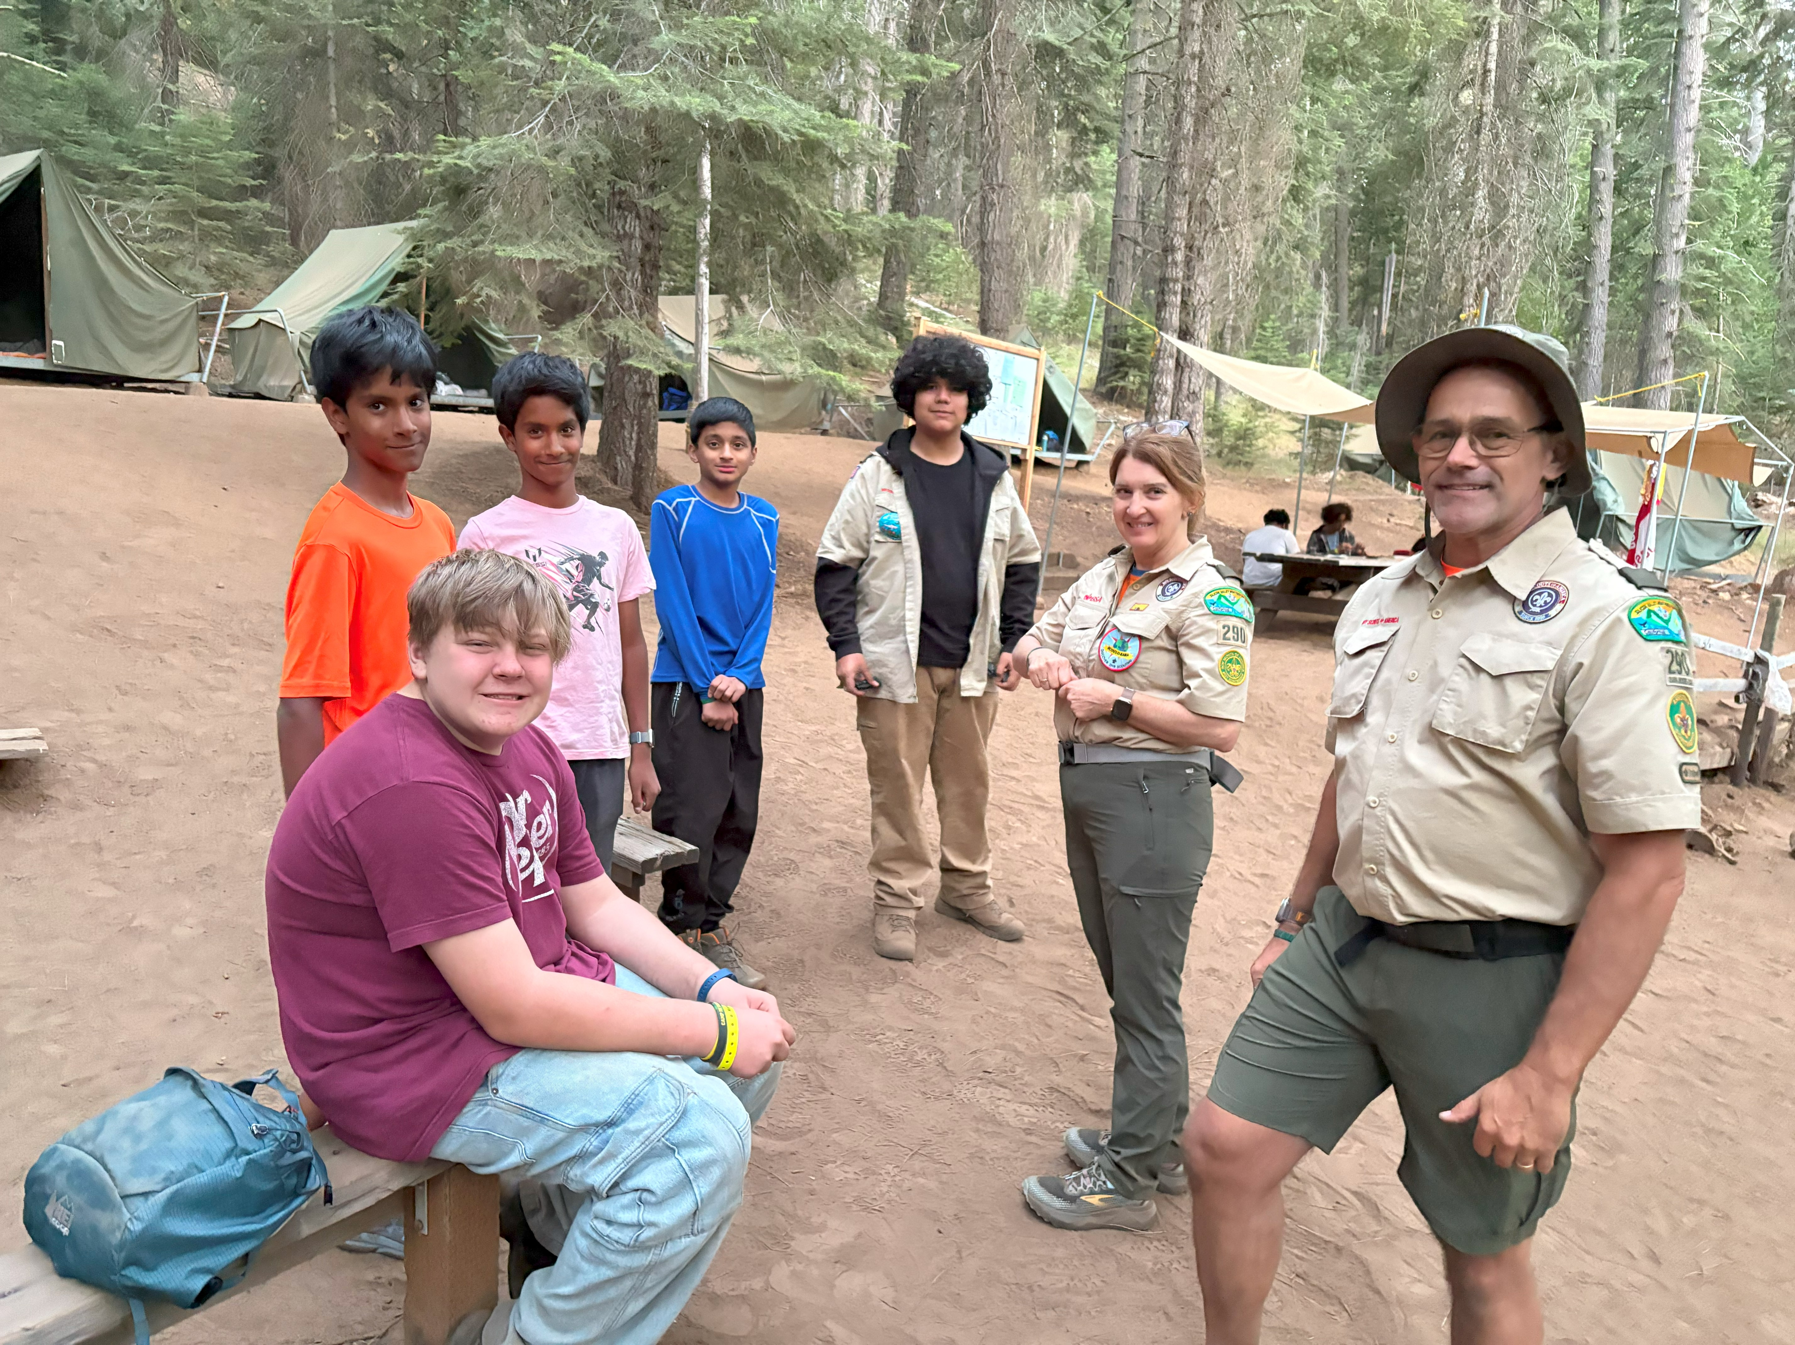
Safety & Policies
Youth Protection essentials
Always 2+ person leadership
All Participating Adults are BSA Registered
Code of Conduct rules
Safety/Medical/dietary processes

Slide 5
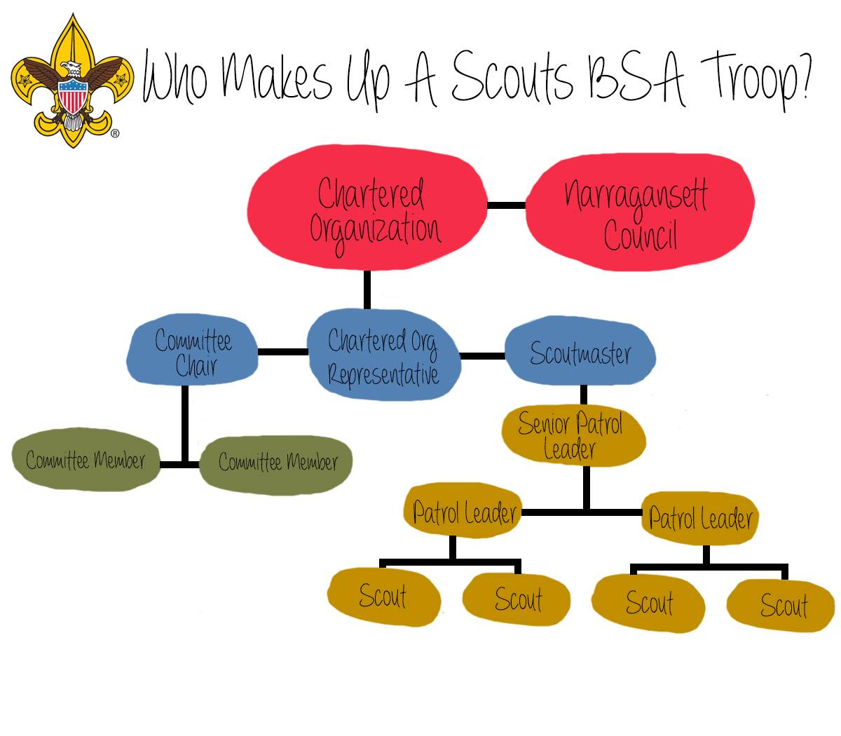
Parent Roles & Volunteer
Troop Org Chart
Examples of roles (big & small)
Call-to-action: sign-up
Activities Coord
Equip Coord
IT/Systems Coord

Slide 6
Money & Fundraising
Dues overview and breakdown
NEW this Year: Split payment:
1. BSA portion via BSA directly
2. Troop 290 Fees to T290
Fundraising from activities
Financial assistance available
Amount | Description
$109 | BSA Nat’l, Council, Insurance
$150 | Troop 290 Annual Fee
($2 Troop Recharter Fee) | ($79 Facility Fees)
($27 Patches, Books) | ($10 Troop Supplies)
($32 Recharter Leaders)

Slide 7
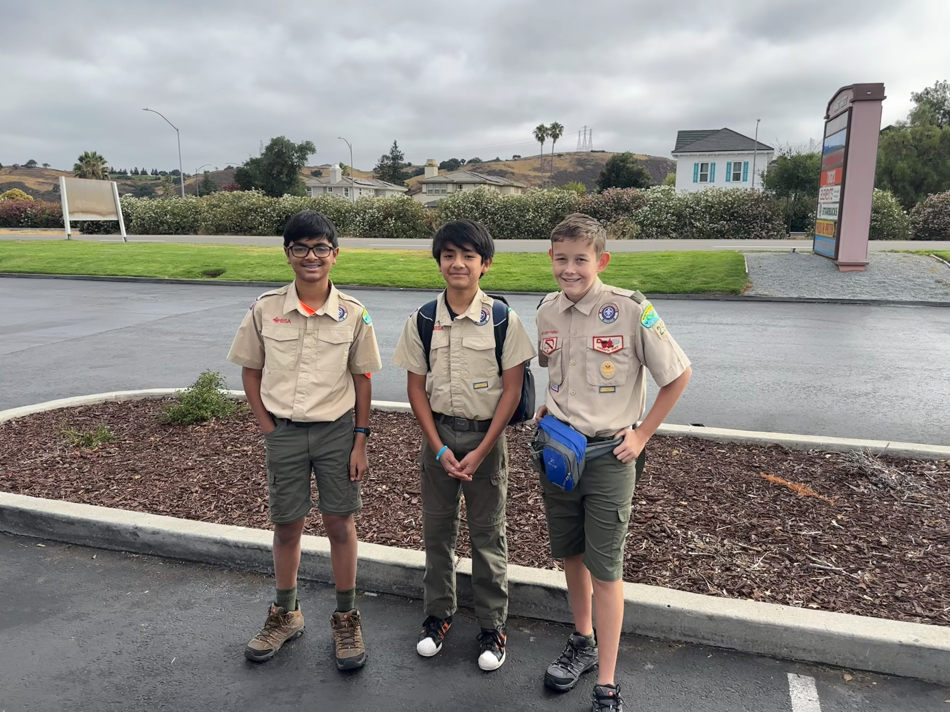
Gear & Uniforms
What’s troop-provided vs. personal
Starting gear list
Uniform standards

Slide 8
Logistics & Communication
Weekly meeting times/locations
Campout sign-up process & deadlines
Communication tools (email, app, calendar)
Troop Website: Calendar
https://www.troop290.org/calendar/
Scoutbook: Advancements
https://scoutbook.scouting.org/book

Slide 9
Wrap-Up & Next Steps
Key upcoming activity:
Troop Open House: October 11th
Volunteer sign-up reminder
Contact info
Jeff Raegen, Committee Chair:
jeff.raegen@gmail.com
408-674-8049

